Slide 1
API Gateway Design

Slide 2
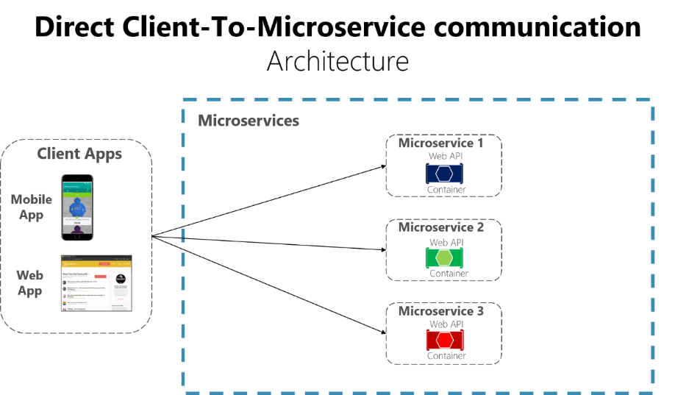
Microservices without API Gateway

Slide 3
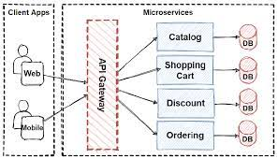
With API Gateway

Slide 4
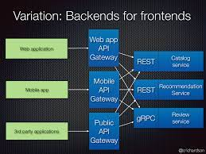
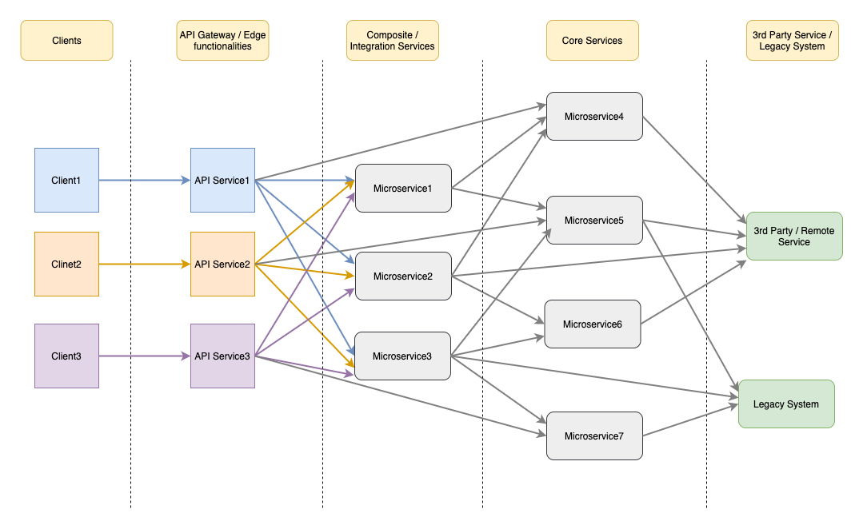
Way to overcome differences in responses and overloading of the gateway

